Slide 1
Sliding Mode Control
SMEET Lab 김진민

Slide 2
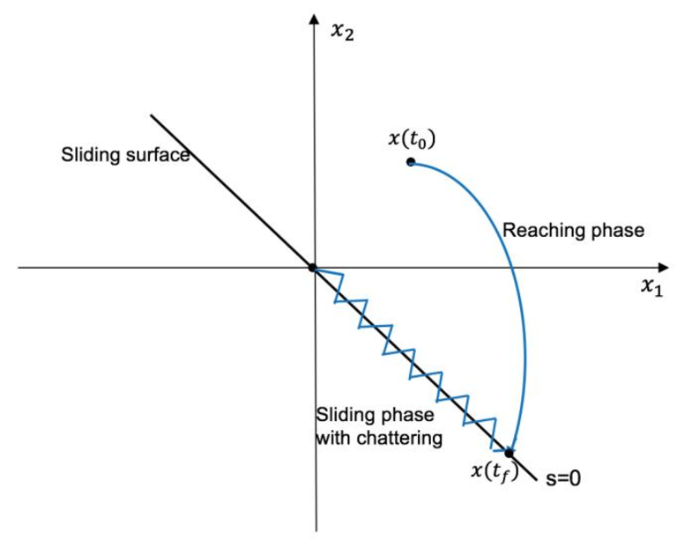
Sliding Mode Control
What is Sliding Mode control?
SMC is a nonlinear control approach which use Relay as the basic control element
Sliding Surface

Slide 3
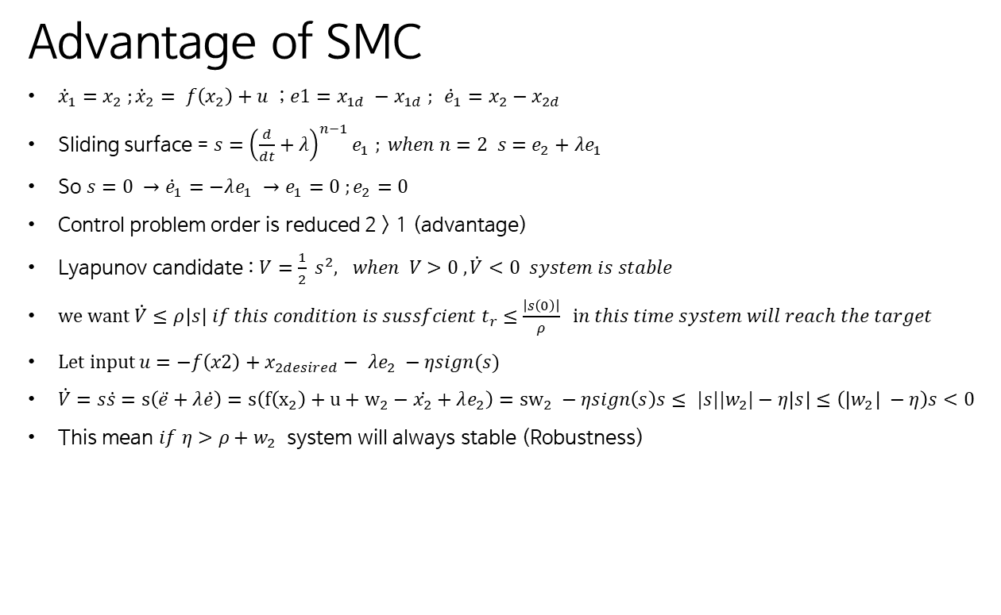
Sliding Mode Control
Advantage of SMC
${\dot{x}}_{1}=x_{2} ;{\dot{x}}_{2}= f\left(x_{2}\right)+u$ ; $e1=x_{1d} −x_{1d} ; {\dot{e}}_{1}=x_{2}−x_{2d}$
Sliding surface = $s={\left(\frac{d}{dt}+λ\right)}^{n−1}e_{1} ; when n=2 s=e_{2}+λe_{1}$
So $s=0 →{\dot{e}}_{1}=−λe_{1} →e_{1}=0 ;e_{2}=0$
Control problem order is reduced 2 > 1 (advantage)
Lyapunov candidate : $V=\frac{1}{2} s^{2}, when V>0 , \dot{V}<0 system is stable$
we want $\dot{V}≤ρ\left|s\right| if this condition is sussfcient t_{r}≤\frac{\left|s\left(0\right)\right|}{ρ} in this time system will reach the target$
Let input $u=−f\left(x2\right)+x_{2desired}− λe_{2} −ηsign(s)$
$\dot{V}=s\dot{s}=s\left(\ddot{e}+λ\dot{e}\right)=s\left(f\left(x_{2}\right)+u+w_{2}−\dot{x_{2}}+λe_{2}\right)={sw}_{2} −ηsign\left(s\right)s≤ |s||w_{2}|−η\left|s\right|≤\left(\left|w_{2}\right| −η\right)s<0$
This mean $if η>ρ+w_{2}$ system will always stable (Robustness)

Slide 4
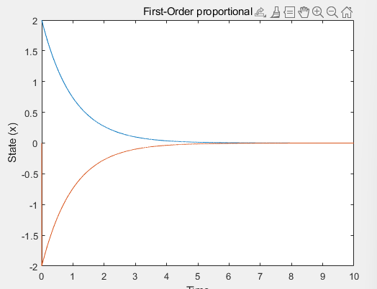
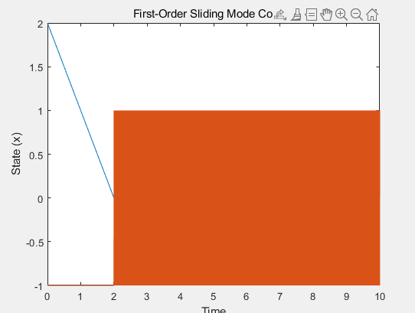
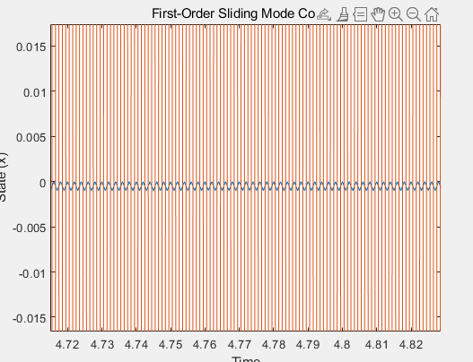

Sliding Mode Control
First Order Sliding Mode Control
Let simple first order Equation : $\dot{x}=u$
Proportional control law : u = -k * (x-x_desired)
SMC ; u = - K sign (x – x_desired)
k=1 , K=1 , x(0) =2 x_desired =0

Slide 5
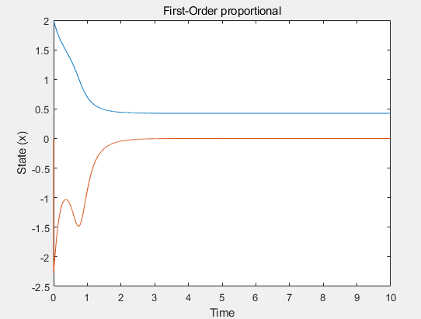
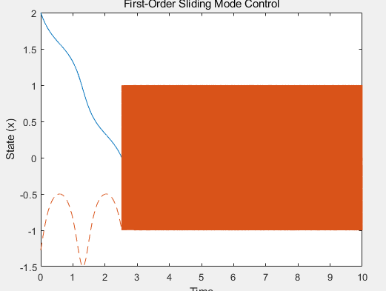
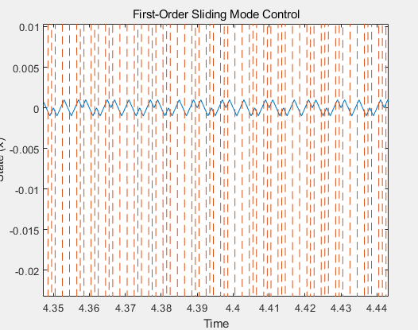

Sliding Mode Control
First Order Sliding Mode Control
$\dot{x}=u$ + d
k=1 , K=1 , x(0) =2 x_desired =0 d= 0.5*sin(5t)

Slide 6
Sliding Mode Control
Chattering analysis
In real system, function Frequency is finite
So, It makes chatering problem
It could solve using boundary layer solution, observer – based solution, regular form solution .etc
In this paper , only consider boundary layer solution

Slide 7

Sliding Mode Control
ISMC
Conventional SMC only guarantees when the system is on the sliding surface. To solve this issue, ISMC is introduced
ISMC can guarantee system initial times instance
$\dot{x}=f\left(x\right)+b\left(x \right)u+h\left(x,y\right)$
$u=u_{0}+u_{1} ; s=s_{0}\left(x\right)+z ; z\left(0\right)=−s_{0}\left(x\left(0\right)\right) ; \dot{z}=−\frac{δs_{0}}{δx}\left\{f\left(x\right)+b\left(x\right)u_{0}\left(x\right)\right\} ;u_{1}=−M\left(x\right)sign(x)$

